Slide 1
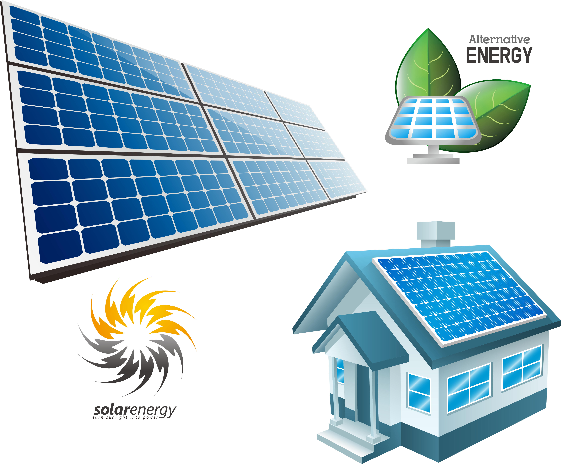
Solar Energy Forecasting
There is a need to transition to green energy to prevent and reverse global climate change. Solar energy sources are a way to supplement energy needs in a clean way. The issue with solar energy is that energy production is dependent on weather conditions and varies throughout the day. If we can predict how much solar energy will be produced, we can modify the traditional power plants to accommodate the fluctuations in solar power. By producing less traditional energy during peak solar hours, we can reduce carbon emissions.
I am trying to predict the amount of energy produced by a grid of solar panels in the next hour given the current weather using machine learning methods.

Slide 2
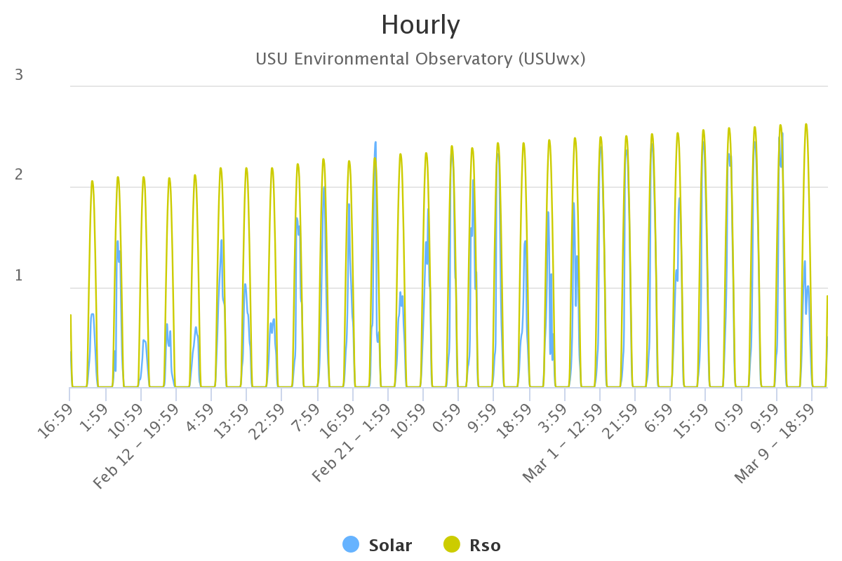
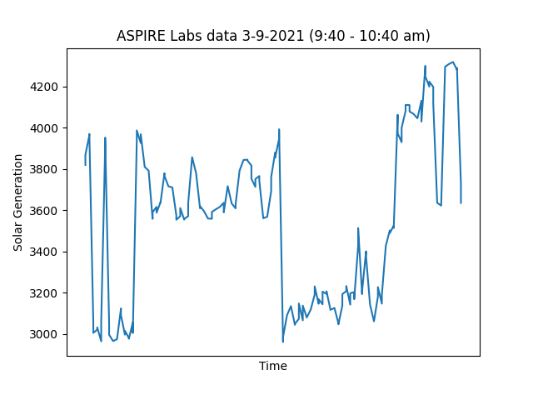
Resources
To solve this problem, we need three main resources, we need weather data (for prediction), actual solar generation data (ground truth), and a machine learning model or network.
Weather Data: The USU Climate center keeps a detailed record of the observed weather. It includes many different columns of information including: humidity, temperature, solar radiation, and more.
Solar Generation: Apire Labs in North Logan has generously agreed to give us the output of their microgrid solar generation
model/network: Python Libraries provide easy to create methods for Machine learning networks. Currently, PyTorch and Keras libraries are being investigated.

Slide 3
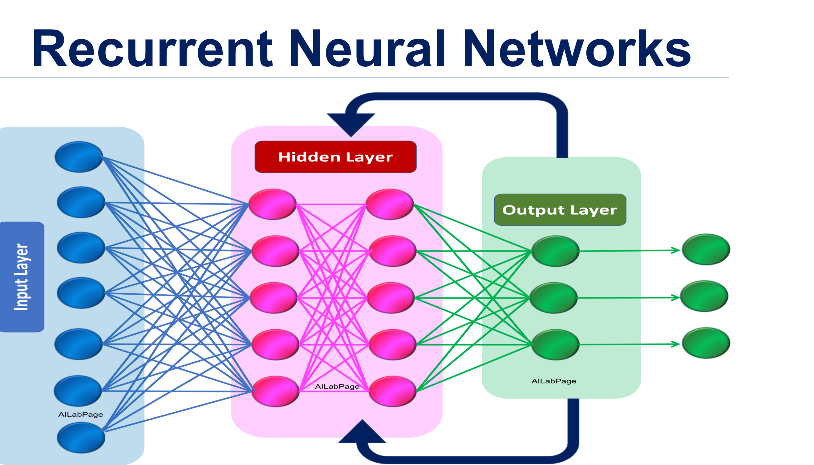
Methods
Recurrent Neural Networks (RNN)s are a commonly used tool in time series forecasting.
They work like an ordinary neural network except the output from previous time steps is 'remembered' and fed into the hidden layers as input for future predictions.

